Slide 1
Image Classification based on scenery
Project guide
Shantala giraddi
Co-guide
Roopa V B
Presented by
Sindhu Hachadad
Shrinivas Miskin
Shriya Bannikop
Sushmita Talawar

Slide 2
Problem Statement
Intel Image Classification: Identify which kind of natural scenes can the image be categorised into.

Slide 3
Motivation
Classification is very important as we use it in daily life. It makes things easier to find and recognise. Differentiation of objects is what allows us to classify them into groups.
Image Classification is one of the core problems in Computer Vision that, despite its simplicity, has a large variety of practical applications.
Moreover, as we can see, many other seemingly distinct Computer Vision tasks (such as object detection, segmentation) can be reduced to image classification.

Slide 4
Objectives
Identify the image.
Classify into respective category.

Slide 5
Scope
The proposed system can be used in any robots so that it can recognise the images and classify.

Slide 6
Constraints
The size of the image should not exceed 30KB.
Image should not contain much noise.
Image must be among the 6 categories.

Slide 7
Literature Survey
Research Paper | Author& YOP | Dataset | Remarks
Multiple Region Categorization for Scenery Images | Tamar Avraham, Ilya Gurvich, and Michael Lindenbaum | An Electronic Lexical Database. | 1)Classified the background region is by its color and textural attributes 2)Boundary shape characteristics
Image classification in remote sensing | Shattri B. Mansor1 and Helmi Zulhaidi Mohd Shafri YOP : 2013 |  | Support vector machine(SVM):Kernel tree ,input data to K-means Classifier.

Slide 8
Analysis of Machine Learning Based Scene Classification Algorithms and Quantitative Evaluation | Himanshu Patel1, Hiren Mewada2 | Caltech-101 dataset | The Naive Bayes is a classification technique based on Bayes' Theorem with a presumption of freedom among indicators. This classifier is working with assumption that presence of feature in one class is non related with presence of other feature
Image Classification Based on the Boost Convolutional Neural Network. | SHIN-JYE LEE, TONGLIN CHEN, LUN YU, AND CHIN-HUI LAI YOP : 2018 |  | Support Vector Machine,daboost algorithm, Random Forest. Regarding image identification, this study intends to artificially extract features, and convert the features of an original image into useful features characterized by lower dimension and less noise.

Slide 9
Description of proposed statement
How do we humans recognize mountains as mountains and trees as trees ?We are good at categorizing scenes based on semantic representation and object affinity, but we know very little about the processing and encoding of natural scene categories in human brain. So basically our task is to identify the image and classify under the category it belongs to.
Identifying natural scenes from all around the world is an interesting computer vision problem. In this problem we are going to classify the images under they belong to and want to see how to experiment with network architecture, hyper parameters , data augmentations and how to deal with loading custom data for test and train.

Slide 10
Block Diagram
Input image
Learning Algorithm
Preprocessing
Feature Extraction
Label Assignment

Slide 11
Requirements
Functional Requirements
User level
*User shall be able to upload the images.
*User shall be able to view the images.
*User shall be able to see the category under which it belongs to.
*User shall be able to view all images under particular category.
System level
*System shall be able to store data in database.
*System shall be able to process identify and classify it in respective
class.
*System should be able to give error message for invalid input.
*System shall not be able to accept the image exceeding 30KB.

Slide 12
B. Non-Functional Requirements
Performance-The system should be able to produce output in less than 5 seconds.
Size of image-size of image should not exceed 30KB.
Maintainability-The system should have long life.
Time –It should be able to give the output in 4-5 seconds.

Slide 13
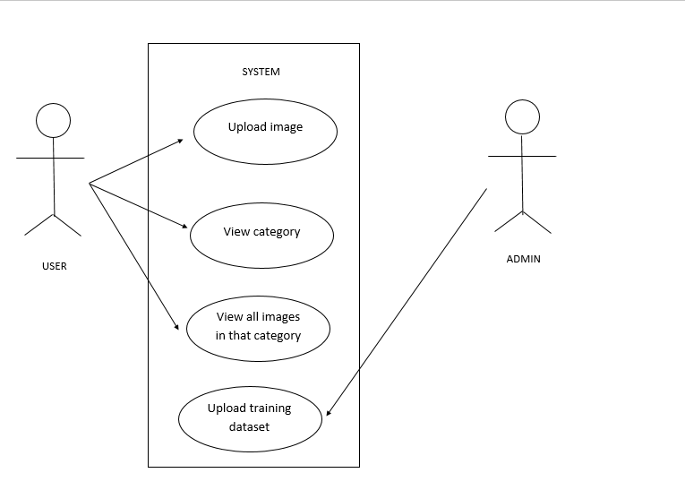
Use Case Diagram

Slide 14
Use Case Description
Use case: | Upload image
Actors: | User
Goal in context: | Image should be uploaded properly.
Precondition: | Should have image→Scenery. →The system should accept scenery image. →The image should not be corrupted.
Post condition: | →The user should be able to upload the image for classification
Main success scenario: | User image is uploaded successfully.
Exception scenario: | →Image size exceeds 30Kb. →The system has crashed due to some internal error

Slide 15
Use case: | View image category
Actors: | User
Goal in context: | User should be able to view the category name to which image belongs
Precondition: | →Image should be uploaded properly.
Post condition: | →The user is able to see the image category in the system.
Main success scenario: | The user is able to view all the specified properties and store them successfully in readable format.
Exception scenario: | →The system crashes. →Algorithm failed to run at runtime.

Slide 16
Use case: | View all images in that category
Actors: | User
Goal in context: | User should be able to view all images under that category
Precondition: | →Image should be uploaded properly. →The image category should be properly specified.
Post condition: | →The user is able to see all the images in that category present in the system.
Main success scenario: | The user is able to view all the category images.
Exception scenario: | →The system crashes. →Algorithm failed to run at runtime.

Slide 17
Use case: | Upload training dataset
Actors: | Admin
Goal in context: | Admin must be able to upload the dataset successfully
Precondition: | →Scenery image dataset should be available. →Model should be able to take the dataset as input for training.
Post condition: | The image dataset is uploaded into the model.
Main success scenario: | The dataset is uploaded properly
Exception scenario: | →The dataset contains image which is not a scenery based image. →image dataset was not uploaded properly

Slide 18
References
https://www.kaggle.com/puneet6060/intel-image-classification
https://link.springer.com/chapter/10.1007/978-3-642-24085-0_5
https://towardsdatascience.com/1st-place-solution-for-intel-scene-classification-challenge-c95cf941f8ed

